Slide 1
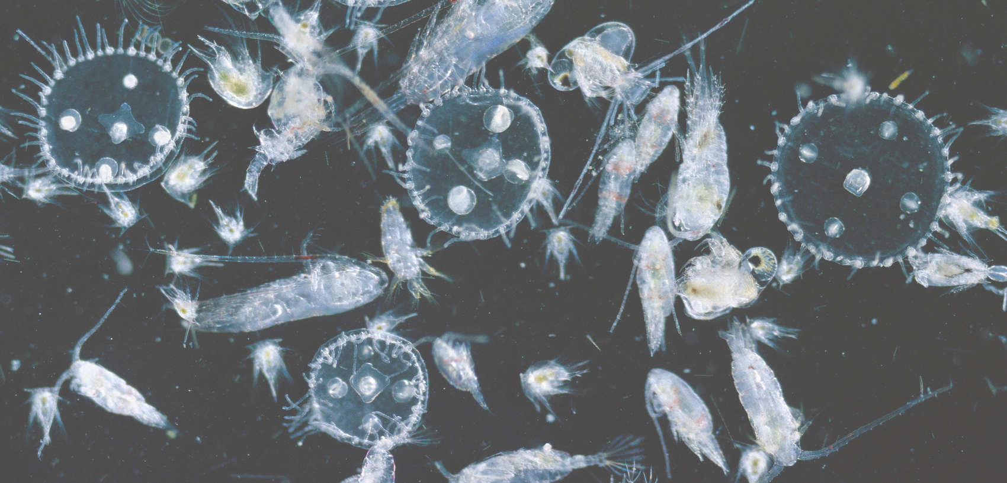
IMPACTS OF OCEAN ACIDIFICATION ON PLANKTON IN THE NORTH ATLANTIC
Silas Peters & Naveen David

Slide 2



Background
DOES ACIDIFICATION AFFECT PLANKTON?
Plankton play a key role in global carbon and nutrient cycles (Falkowski, 2012)
Some plankton show susceptibility to acidification (EX - Spisla et al., 2021)
pCO2 is a measure of the amount of carbon dioxide in the ocean. The more CO2 there is, the lower the pH (more acidic; Monitoring, 2024).
Plankton and pCO2 data are both collected via long-term studies and thus there are large amounts of it accessible

Slide 3
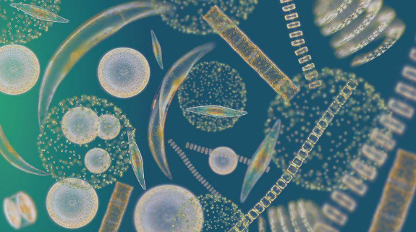
HYPOTHESES AND PREDICTIONS
Hypothesis: pH effects the diversity of plankton
Prediction: increases in pCO2 (i.e., decrease in pH) will lead to a decrease in the diversity of plankton

Slide 4
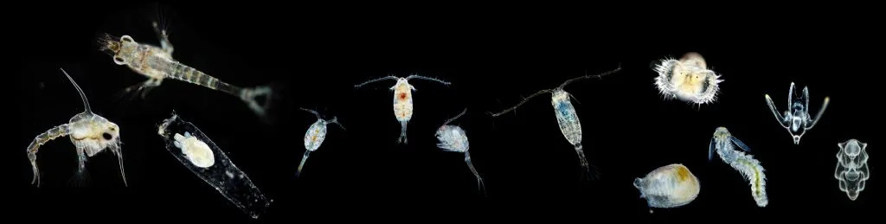
Data source for plankton
Data wrangling for plankton
Data was filtered between 1991 and 2018 as plankton data was unavailable between 1986 to 1991, and the pCO2 data was available until 2018. The full area was available and was able to match the PCO2 data, thus it was not filtered. Plankton taxa added after 1991 were originally filtered out but do not affect diversity, so were kept in final analysis. The dataframe was pivoted longer.
Plankton data is from the Continuous Plankton Recorder (CPR) Survey, uploaded onto BCO-DMO (Helaouet et al., 2024). It is a continuous long-term sampling project that took place over 90 years in the north Atlantic. Recorders are towed behind ships and plankton are identified by taxonomic experts (Richardson et al., 2006).

Slide 5

Data source for pCO2
Data wrangling for pCO2
PCO2 data is from a National Oceanic and Atmospheric Administration (NOAA) database consisting of millions of datapoints from different expeditions. Data was quality-controlled by NOAA on the basis of internal consistency, reliability of CO2 calibrations, and other parameters (Takahashi, Sutherland & Kozyr, 2017).
Data was first filtered to spatially overlap with where plankton data was collected in the North Atlantic. PCO2 data was then filtered to the longest stretch of years where plankton data was consistently available (1991-2018).

Slide 6

Calculating diversity for plankton
Diversity is a common measure used in community ecology. In our study, we utilized Shannon’s Diversity Index, which is a measure of species diversity in a given community that takes into account both abundance and species evenness (Morin, 2011).
Equation is seen to the right. The package ‘vegan’ was used to calculate the Shannon’s Diversity Index for each year (Oksanen et al., 2024).
p = fraction of the total number of individuals in the sample that belong to species i
Sum for all species present in the community (Morin, 2011)

Slide 7
Preparing PCO2 data for analysis
For our analyses, we needed as many datapoints for PCO2 as we had for plankton diversity.
Since we had one diversity datapoint per year, we filtered down our PCO2 data by calculating the median observation for each year.
We did this by using group_by(year) and then using the across() function to apply median() to multiple columns

Slide 8
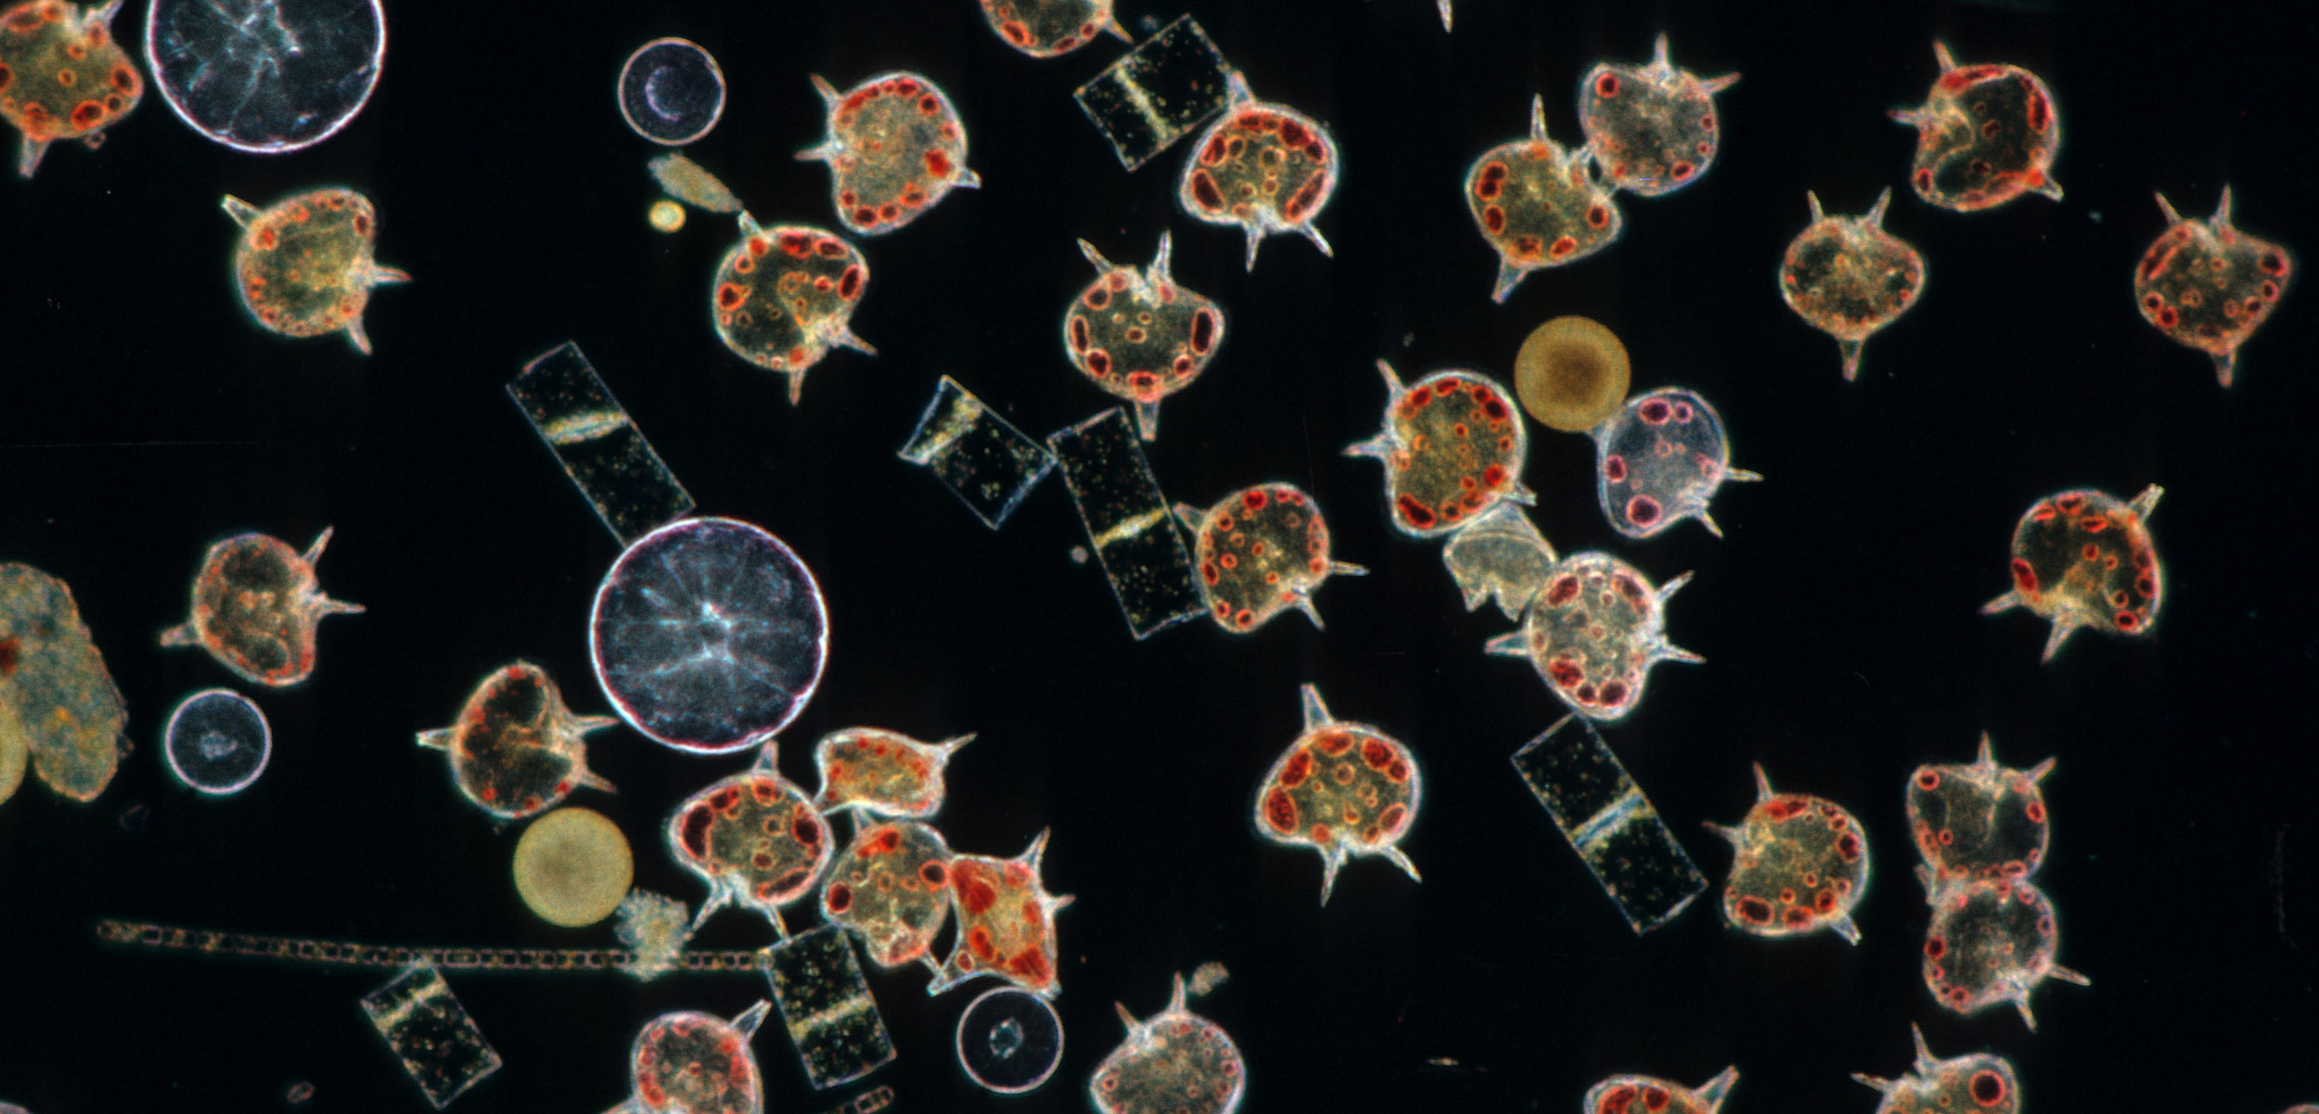
Data was turned into a time series format using ts()
Both pCO2 and diversity indices were plotted across time to illustrate trends across time
A cross-correlation was performed using the ccf() function
This function examines how the values of diversity may be related to past values of pCO2
An ARIMA model was autofitted using auto.arima() which finds the model with the lowest AIC value
This is a model used to predict future values based on past values. We checked the fit using the Ljung-Box test
The forecast() function was used to forecast pCO2 values into the future (Hyndman et al., 2024)
Values for the forecast were extracted and turned into numeric values
The forecast() function was used again to forecast diversity indices, with pCO2 forecasted values as the xreg argument (Hyndman et al., 2024)
Statistical methodology - time series
Learn and Act Lecture Series: Orcas

Slide 9
Plankton diversity and median pCO2 were combined into a single dataframe using merge()
Median pCO2 was plotted against time to examine temporal trends
A simple linear model was constructed using lm() with a formula of Shannon’s diversity ~ Median pCO2
Model diagnostics were assessed using plot()
A linear model was then constructed using lm() with a formula of Median pCO2 ~ Year, and was used with the predict() function to predict pCO2 values from 2019-2035
These predictions were used alongside the original model to create predictions for plankton diversity from 2019-2035
Statistical methodology - linear model
Learn and Act Lecture Series: Orcas

Slide 10
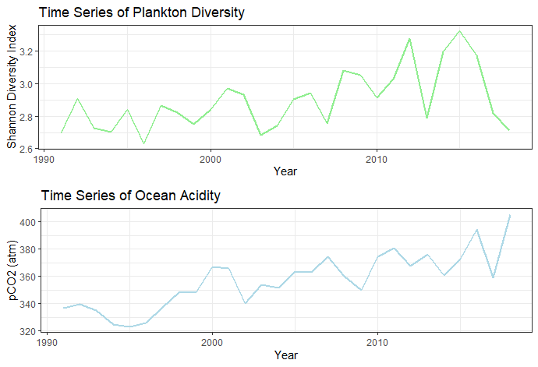
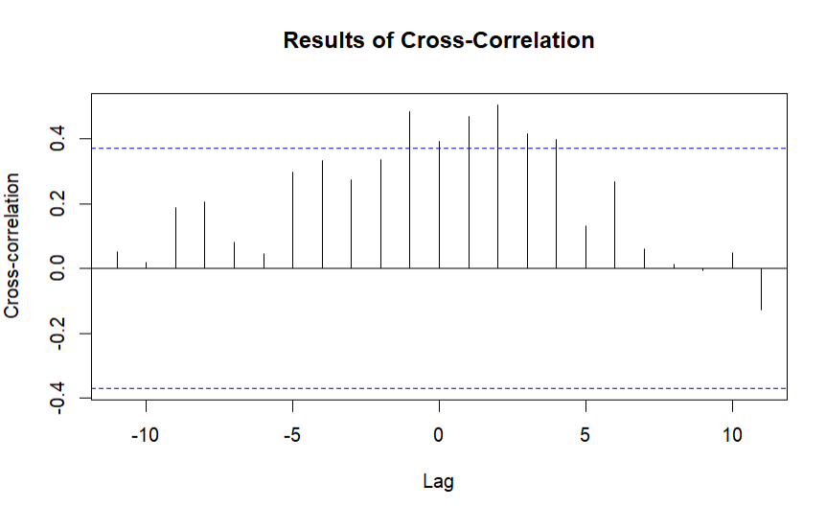
Both plankton diversity and ocean acidity change over time, with an overall increasing trend
Fig. 2 is the cross-correlation plot showing the relation between x(t + k) and y(t). Blue lines represent confidence intervals. The most dominant correlations appear between h = -1 and 4.
Results
TIME SERIES CURRENT ANALYSIS
Figure 1: Time Series of Variables 1991 - 2018
Figure 2: Plot of Cross-Correlation Values

Slide 11
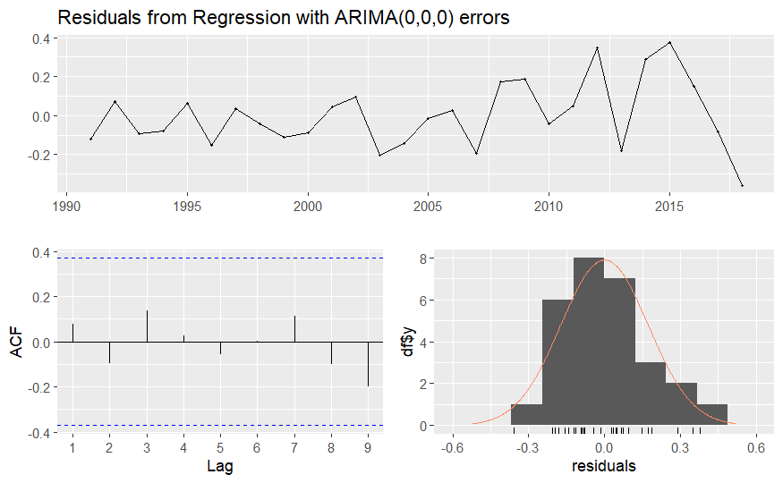
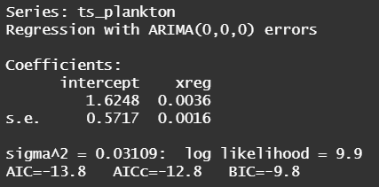
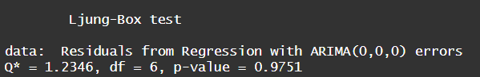
TFigure 3 shows the output of auto.arima(), providing the ARIMA model with the lowest AIC score.
Our Ljung-Box Test indicates that this model fits well, as the p-value is above 0.05. Residuals also indicate a good model fit.
Results
CHECKING OUR MODEL
Figure 5: Examining Residuals to Confirm Model Fit
Figure 3: ARIMA Model Values
Figure 4: Results of Ljung-Box Test

Slide 12
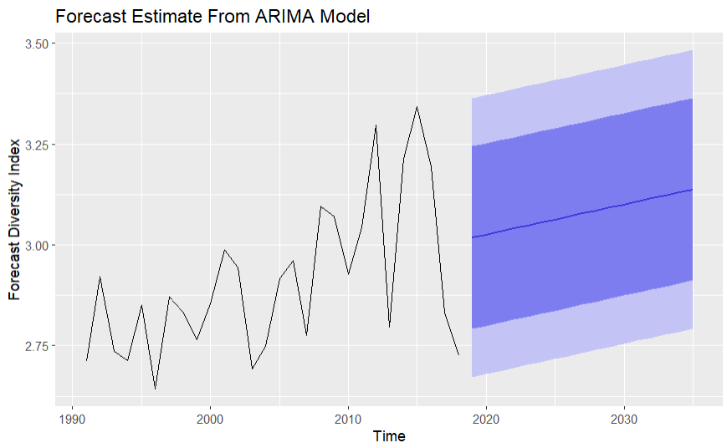

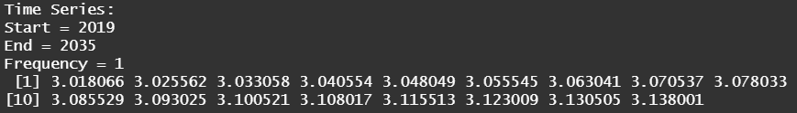
The forecast uses the ARIMA model and the predicted values of pCO2
We can see that diversity is increasing over time until 2035, from around 3.01 to 3.13
Results
FORECAST USING TIME SERIES
Figure 8: Plot of Forecast Plankton Diversity
Figure 6: Forecast Values of pCO2
Figure 7: Forecast Values of Plankton Diversity

Slide 13
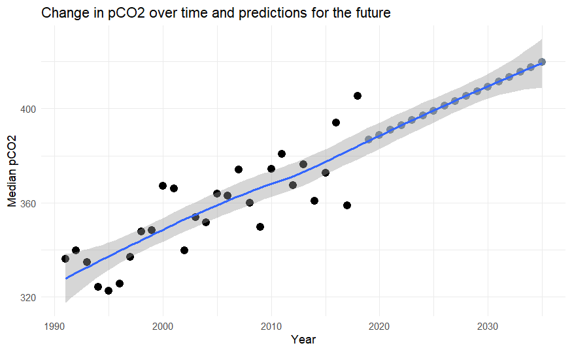
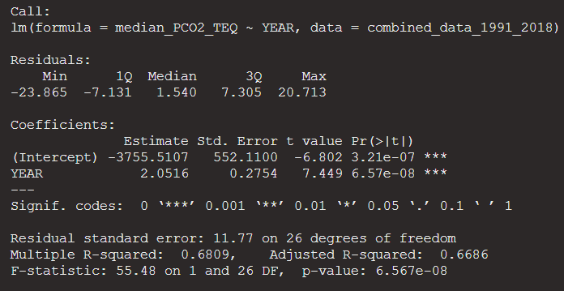
Results
DOES PCO2 CHANGE OVER TIME?
pCO2 clearly shows a trend of increasing over time. Predicted values are shown in gray.
Figure 9: Change in pCO2 over time and into the future.
Figure 10: pCO2 ~ year model values

Slide 14
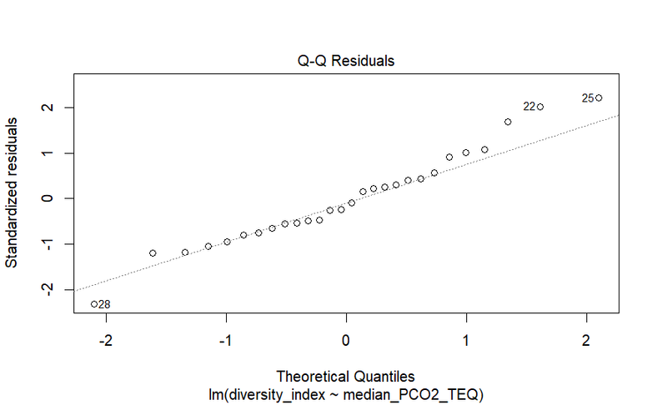
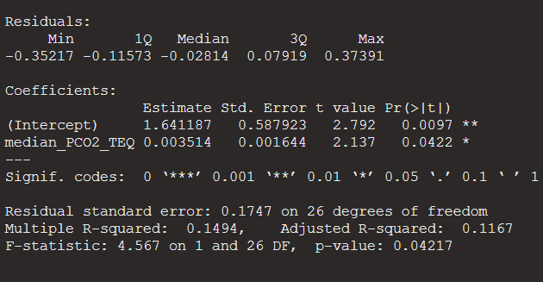
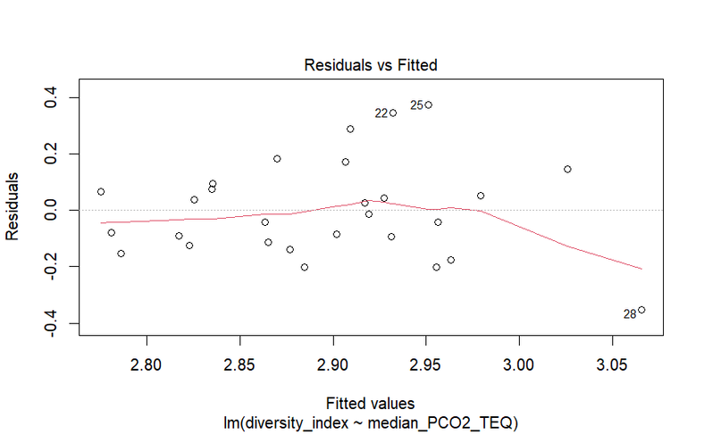
Our model shows a significant (p=0.042) effect of pCO2 on plankton diversity. However, diagnostic plots suggest that it doesn’t perfectly satisfy linear model assumptions.
Results
TESTING THE LINEAR MODEL
Figure 12: Diagnostic plots
Figure 11: Diversity ~ pCO2 model values

Slide 15
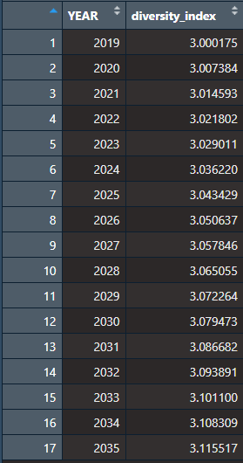
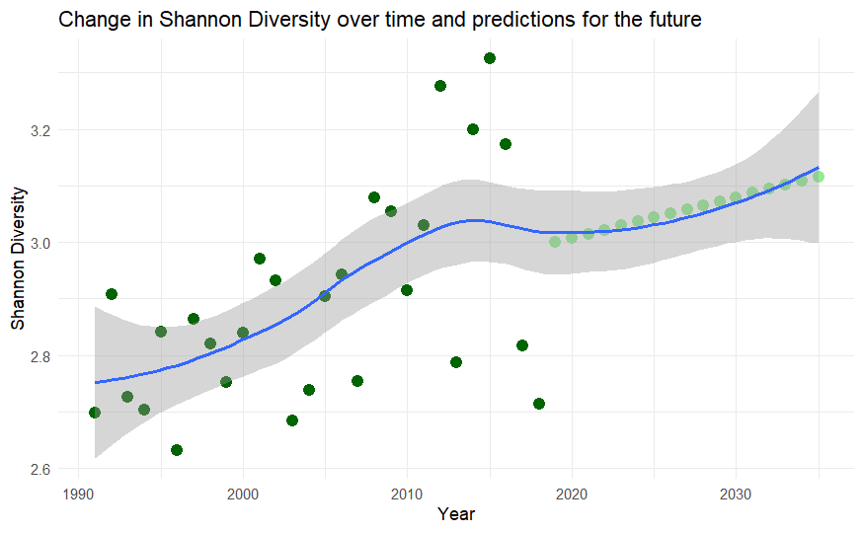
Figure 14: Predicted values of Shannon Diversity from 2019-2035
Results
PREDICTING THE FUTURE?
Our model predicts that Shannon Diversity should increase over time
Figure 13: Change in Shannon Diversity over time and into the future

Slide 16


WHAT DOES THIS MEAN FOR PLANKTON?
Our initial prediction that pCO2 would negatively impact plankton is not supported by our models. There is some support for our hypothesis as pCO2 does seem to affect plankton diversity positively, but this may be due to other unknown variables.
It is important to note that diversity does not increase significantly (from 3 to 3.1)
There are a few reasons this may occur:
Rare taxa may increase in abundance, leading to higher evenness
Species may be migrating towards the poles as oceans warm, increasing diversity
Increasing temperatures may support larger populations, increasing abundance

Slide 17
POTENTIAL NEXT STEPS
examining other variables such as temperature
try different transformations to better satisfy model assumptions
examining susceptible versus resistant taxa
fitting ARIMA model ourselves

Slide 18

THANK YOU!
Any questions?
Learn and Act Lecture Series: Orcas

Slide 19
References
Falkowski, P. (2012). Ocean Science: The power of plankton. Nature, 483(7387), S17–S20. https://doi.org/10.1038/483S17a
Helaouet, P., Sheppard, L., Johns, D. (2024) Continous Plankton Recorder phytoplankton and zooplankton occurrence and count data from The CPR Survey in the Western North Atlantic Ocean from 1958 to 2021. Biological and Chemical Oceanography Data Management Office (BCO-DMO). (Version 5) Version Date 2024-08-29. doi:10.26008/1912/bco-dmo.765141.5 [Retrieved 23 November 2024]
Hyndman R, Athanasopoulos G, Bergmeir C, Caceres G, Chhay L, O'Hara-Wild M, Petropoulos F, Razbash S, Wang E, Yasmeen F (2024). _forecast: Forecasting functions for time series and linear models_. R package version 8.23.0, <https://pkg.robjhyndman.com/forecast/>.
Monitoring. NOAA Ocean Acidification Program. (2024, November 14). https://oceanacidification.noaa.gov/ocean-acidification-research/ocean-acidification-monitoring/#:~:text=pCO2,the%20atmosphere%20with%20elevated%20emissions.
Morin, P. J. (2011). Community Ecology. John Wiley & Sons.
Oksanen J, Simpson G, Blanchet F, Kindt R, Legendre P, Minchin P, O'Hara R, Solymos P, Stevens M, Szoecs E, Wagner H, Barbour M, Bedward M, Bolker B, Borcard D, Carvalho G, Chirico M, De Caceres M, Durand S, Evangelista H, FitzJohn R, Friendly M, Furneaux B, Hannigan G, Hill M, Lahti L, McGlinn D, Ouellette M, Ribeiro Cunha E, Smith T, Stier A, Ter Braak C, Weedon J (2024). _vegan: Community Ecology Package_. R package version 2.6-8, <https://CRAN.R-project.org/package=vegan>.
R Core Team (2024). _R: A Language and Environment for Statistical Computing_. R Foundation for Statistical Computing, Vienna, Austria. <https://www.R-project.org/>.
Richardson, A. J., Walne, A. W., John, A. W. G., Jonas, T. D., Lindley, J. A., Sims, D. W., Stevens, D., & Witt, M. (2006). Using continuous plankton recorder data. Progress in Oceanography, 68(1), 27–74. https://doi.org/10.1016/j.pocean.2005.09.011
Spisla, C., Taucher, J., Bach, L. T., Haunost, M., Boxhammer, T., King, A. L., Jenkins, B. D., Wallace, J. R., Ludwig, A., Meyer, J.,
Stange, P., Minutolo, F., Lohbeck, K. T., Nauendorf, A., Kalter, V., Lischka, S., Sswat, M., Dörner, I., Ismar-Rebitz, S. M. H., … Riebesell, U. (2021). Extreme Levels of Ocean Acidification Restructure the Plankton Community and Biogeochemistry of a Temperate Coastal Ecosystem: A Mesocosm Study. Frontiers in Marine Science, 7. https://doi.org/10.3389/fmars.2020.611157
Takahashi, Taro; Sutherland, Stewart C.; Kozyr, Alex (2017). LDEO Database (Version 2019): Global Ocean Surface Water Partial Pressure of CO2 Database: Measurements Performed During 1957-2019 (NCEI Accession 0160492). NOAA National Centers for Environmental Information. Dataset. https://doi.org/10.3334/cdiac/otg.ndp088(v2015). Accessed 24 November 2024.
Wickham H, Averick M, Bryan J, Chang W, McGowan LD, François R, Grolemund G, Hayes A, Henry L, Hester J, Kuhn M, Pedersen TL, Miller E, Bache SM, Müller K, Ooms J, Robinson D, Seidel DP, Spinu V, Takahashi K, Vaughan D, Wilke C, Woo K, Yutani H (2019). “Welcome to the tidyverse.” _Journal of Open Source Software_, *4*(43), 1686. doi:10.21105/joss.01686 <https://doi.org/10.21105/joss.01686>.

